Slide 1
Course Introduction
Welcome to ENGL 3110

Slide 2
Refresher
Core Elements of all Sentences
  Noun (head of a noun phrase)
  Verb (head of a verb phrase)
Open-Class Modifiers
  Adjectives (head of an adjective phrase)
    Can modify nouns or words acting as nouns
  Adverbs (head of an adverb phrase)
    Can modify verbs, adjectives, other adverbs, or whole sentences

Slide 3
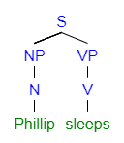
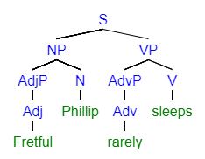
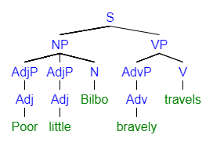
Sample Diagrams

Slide 4
Refresher
Nouns and Noun Phrases
  Nouns can….
    Usually become plural
    Usually be replaced by a pronoun
    Usually be modified by a determiner (a, an, the)
  Noun Phrases can be…
    Subjects: Pettiness is a grave sin.
    Objects: I gave a high-five to my nurse.
    Complements: John is a right bastard.

Slide 5
Refresher
Verbs and Verb Phrases
  Verbs can….
    Usually become past tense
    Usually be preceded by a modal (can, may, will)
  Verb Phrases can be…
    Predicates: I truly love reading books.
    Gerunds (in a subject position): Mowing the lawn is not my favorite thing.
    Gerunds (in an object position): I hate mowing the lawn.

Slide 6
Refresher
Adjectives and Adjective Phrases
  Adjectives can….
    Often become Adverbs by adding –ly (happy – Happily)
    Often be made comparative by adding –er (happier)
    Usually be modified by an adverb (very tall)
    Usually modify a noun: The tall man.
  Adjective Phrases can be…
    Noun Modifiers: The tall man…
    Compliments: I am tall.

Slide 7
Refresher
Adverbs and Adverb Phrases
  Adjectives can….
    Often end in –ly
    Usually modify a verb (suddenly appeared)
    Usually be modified by other adverbs (very suddenly)
  Adverb Phrases can be…
    Verb modifiers: It suddenly appeared.
    Adjective modifiers: He is truly unhappy.
    Sentence modifiers: Unfortunately, I ate the whole cake.

Slide 8
Refresher
Pronouns
  Closed Class
  Replaces an entire Noun Phrase (not just a noun)
Examples
  Personal (I, You, We, They)
  Reflexive (Itself, Ourselves)
  Demonstrative (This, These, Those)
  Interrogative/Relative (That, Who, What, Where)

Slide 9
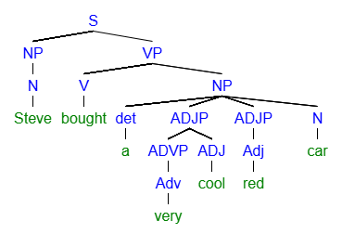
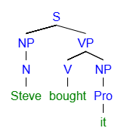
Refresher
Pronouns replace Noun Phrases

Slide 10
Refresher
Determiners
  Determiners a “closed class” that modify nouns
  Not every noun phrase has a determiner
Types of Determiners
  Articles (a, an, the)
  Demonstratives (this, that, those)
  Possessives (Bob’s, my, their, its)
  Quantifiers (many, some, all)
  Numbers (one, three, a hundred)
    Some linguists classify numbers as their own separate closed class

Slide 11
Refresher
What are some tricks to be able to tell apart a determiner and an adjective?
  Determiners usually precede Adjectives.
    The big, red, bouncy ball.
  Most nouns can only take one or two determiner but infinite pronouns
    A few big, red, bouncy balls.
  Most adjectives are “gradeable” but most determiners are not.
    I lost very my books.
    I love very special books.

Slide 12

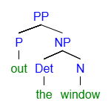
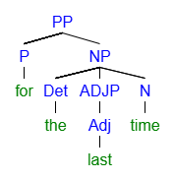
Refresher
Prepositions (Closed Class)
    “Anywhere a cat can be”
    In, On, Of, To, With, For, By, Near, Towards, “Away From”…. LIST
Prepositional Phrases (P + NP)
  Prepositions are usually followed by a Noun Phrase

Slide 13
Refresher
Prepositional Phrase Positions and Functions
  Noun modifiers: The man in the hat.
  Verb modifiers: …swam in the sea.
  Adjective Modifiers: …high on the mountain
  Sentence modifiers: In the morning, I shall perish

Slide 14
End of Class
If you have questions or concerns, hang around to talk.

